Slide 1
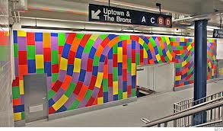
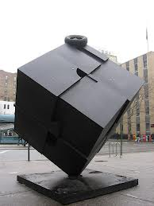
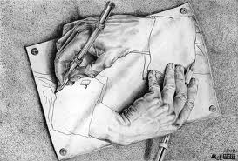
Welcome to Geometry!

Slide 2
Tonight’s Agenda
Typical Class Day
Curriculum (Scope and Sequence)
Grading
Tutoring & PBA’s
How can you help?
Questions

Slide 3
Typical Class Day
Warm-Up/Do Now
Announcements (Progress Recap)
Homework Check
Notes & Examples
Team Practice Problems
Lesson Check
Homework Assignment

Slide 4
Curriculum (Scope and Sequence)
Building the Foundations of Geometry (Fall Semester)
Extending the Foundations of Geometry (Spring Semester)
Essentials of Geometry
Reasoning and Proof
Parallel and Perpendicular Lines
Congruent Triangles
Relationships within Triangles
Polygons and Quadrilaterals
Similarity
Right Triangles and Trigonometry
Transformations
Surface Area & Volume
Circles

Slide 5
Grading
90% of grade is mastery of Learning Targets:
5% Classwork
10% Homework
10% Quizzes
15% Performance Tasks/Projects
20% Semester Final Exam
30% Tests
10% of your grade is Preparation and Participation (including attendance)

Slide 6
ENGRADE
All grades are readily available on engrade.com
If you have not received an e-mail invite, please send me an e-mail at slozada@beaconschool.org

Slide 7
Homework
Grading (10% of average)
Facts to Know:
EFFORT:
Check plus (150%): above and beyond
Check (100%): all problems attempted
Check minus (50%): incomplete
ONLY in pencil
Nightly homework always due the following class period
NO LATE HW accepted (if you are late to class then your hw is late)

Slide 8
Performance Tasks/Projects
Grading (15% of average)
Analytic Holistic Rubric
Developing Autonomy
Solution Process
Conclusion/Answer

Slide 9
Exams
Grading (30% of average)
ACCURACY:
Organized by learning target to assess your child’s progress on the Common Core Learning Standards
REMEDIATION:
TUTORING
Extra practice problem packet to remediate and solidify concepts (project grade)
Exam corrections in class

Slide 10
Tutoring & PBA’s
Tutoring & Office Hours
PBA’s
Monday E Band & Thursday H Band in Room 316
Two semester final examinations
Course project(s) assigned and assessed through the year based on the Mathematics Department rubric

Slide 11
How can you help your child succeed?
Talk to your child about his or her day: What did you learn in math today?
Check your child’s HW understanding: Are you understanding what you are doing or are you having problems?
If your child is having difficulties, please encourage them to see Ms. Lozada for tutoring ASAP

Slide 12
Questions

